Slide 1
Finding Best Supervised Regression Model
Suman Paudel
33

Slide 2
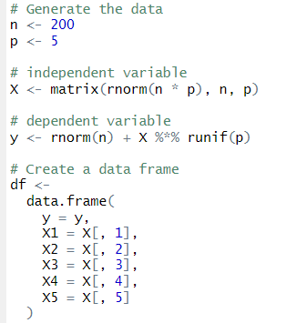
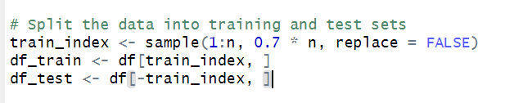
At first continuous dependent and Independent Variable is generated from rnom() and runif() functions then created a dataframe. After that I have splitted dataset into training and test sets.

Slide 3
Since, data is already taken from the normal distribution. We need have to worry about the distribution of dependent and independent variables.
Some Assumptions of Linear Regression.
Data should normal
There is linear relationship between the dependent and independent variables.
Should Pass BLUE estimate (correlation, coefficient of determination > 0.5, Y-intercept (a) an slope (b) must be statistically significant.
Should be LINE (Linear, Independent, Normal, Equal Variance) of residuals.
No Multicollinearity.

Slide 4
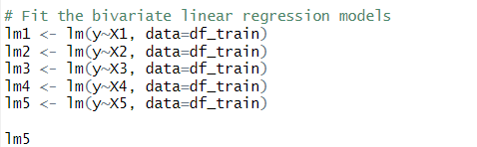
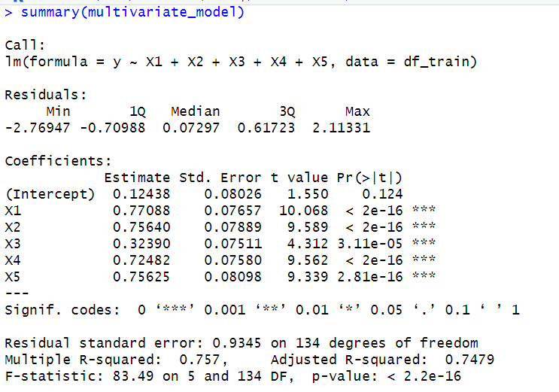
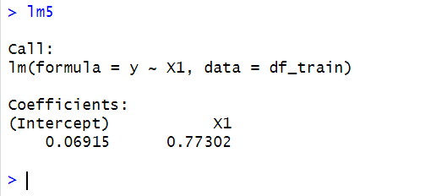
Bivariate and Multivariate

Slide 5
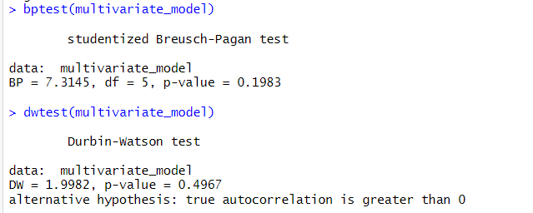
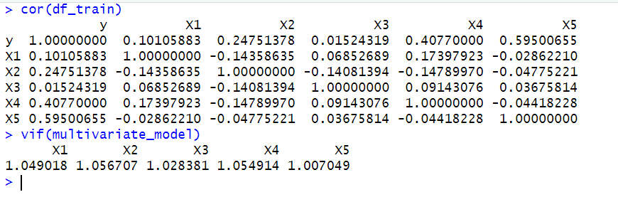
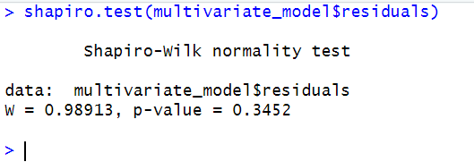
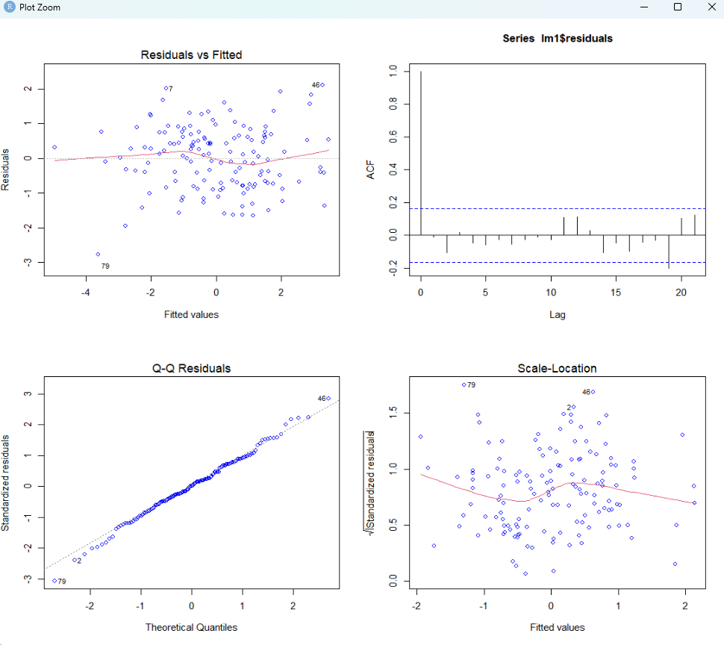
BLUE AND LINE Test

Slide 6
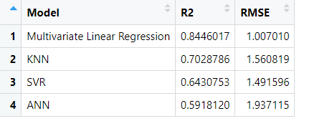
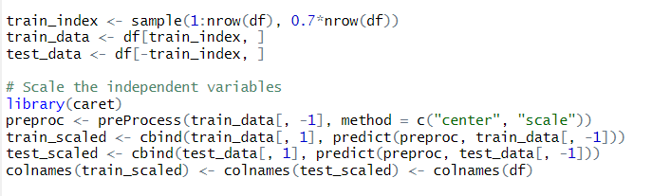
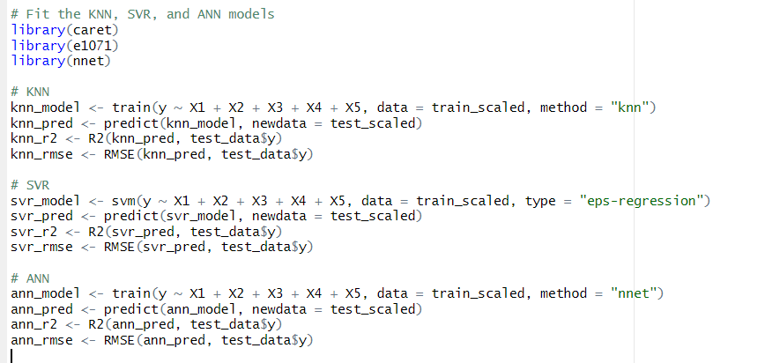
Finding Best Regression Model
The best model is Multivariate Linear Regression with highest R2 and lowest RMSE

Slide 7
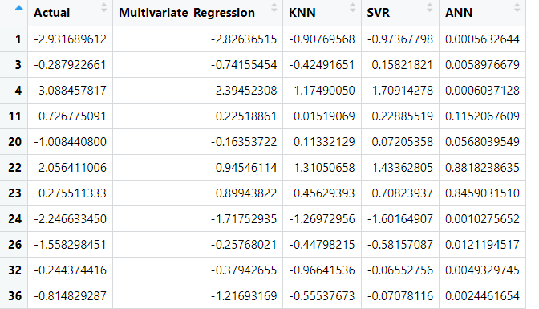
Predicted Values

Slide 8
Thank You
Any Questions?

